Slide 1
Intelligent low-altitude air traffic management system
Professor Peng Wei
Humaid Al-Kaabi - Electrical Engineering
Jun An Tan - Electrical Engineering
Suhail Aldhaheri - Electrical Engineering
Saad Alsudayri- Electrical Engineering

Slide 2
Problem
The number of the aircrafts that fly in low altitude has recently increased and there is a need to find a good way to manage the traffic of these aircrafts to prevent collision and find the best trajectories for these aircrafts in order to have safe environment
Notes:
humaid

Slide 3
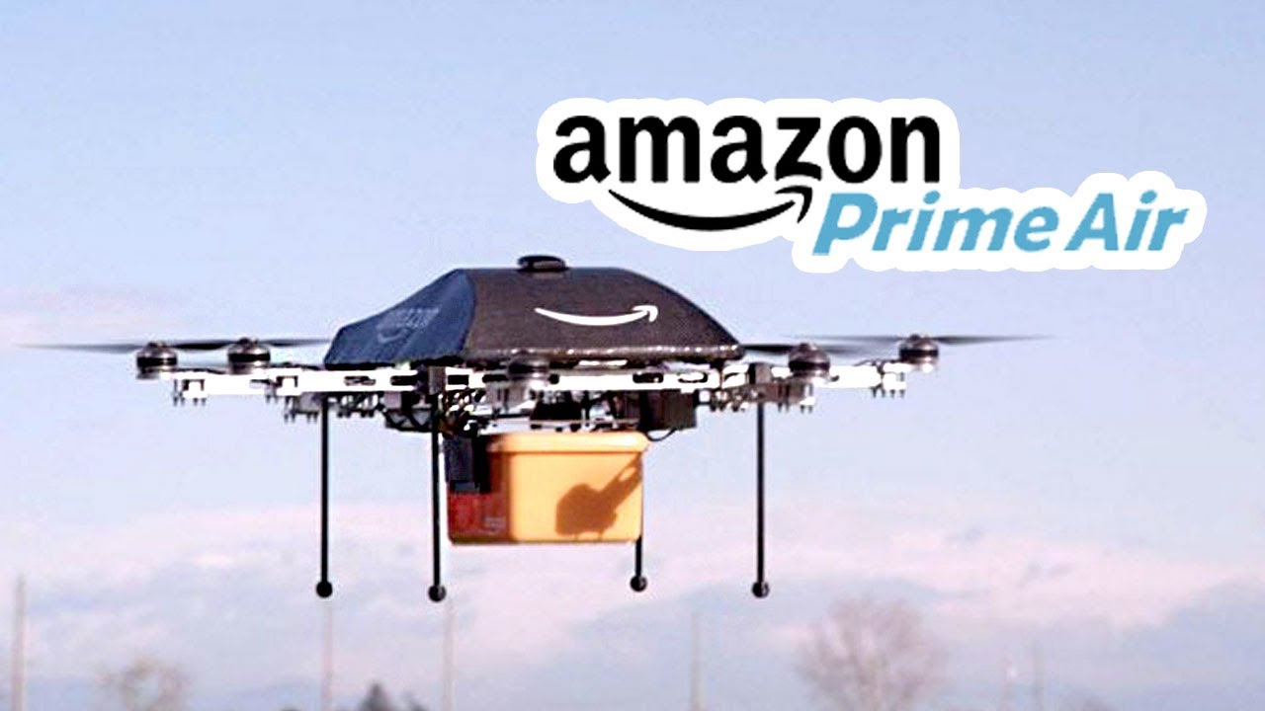
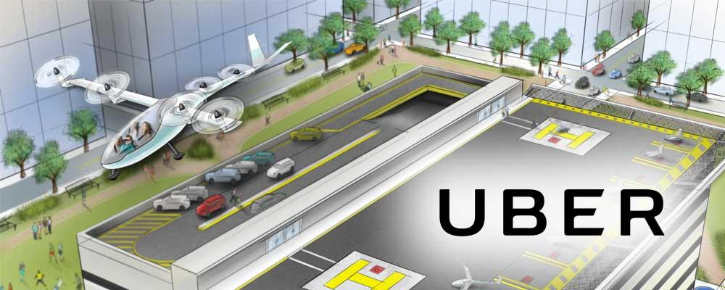
Our target
Delivery companies such as Amazon PrimeAir
Transport companies such as Uber Elevate
Notes:
suhai

Slide 4
What does our software do?
Main Idea:
A software that get a demand from a user and give the best way to meet this demand
Our goal:
1- Find the closest supplier or fastest supplier for a given demand
2- Set good trajectories for the aircraft.
3- Keep track of the aircrafts and prevent collisions.
Notes:
Suhail

Slide 5
How does the Software work?
Input of the software:
User demands: groceries, ride, delivery …………………….
Suppliers: warehouse, aircrafts ……………………...
Inside the software:
Calculation for the best trajectories considering:
Distance - time
Safety - flying zones, collisions
Rules - FAA
Notes:
Jun An Tan

Slide 6
How does the Software work?
output :
Safe trajectories for the aircrafts.
No possible collision.
Data for the nearby aircrafts
Warning in case an aircraft might collide with another aircraft
Notes:
Jun An Tan

Slide 7
Functional and Non-functional requirements
3 main symbols for separating warehouses, drones and demands
Flight paths of drones will be in a straight line
Demands to be removed after completion
At no time should there be any collision
Displaying our output at any Front end GUI
Non:
Commenting our code
Indenting our code making sure it’s neat

Slide 8
Constraints/Considerations
For this semester we built the software assuming the following:
The warehouses have limited supplies.
Each warehouse has one aircraft.
The trajectories are straight lines (no turns).
Aircraft must return to the departure point (The warehouse).
For the next semester we will assume the following:
Warehouses will have limited supplies to deliver.
Warehouses can have more than one drone.
The trajectories will not just be straight lines.
Aircrafts can return to different warehouse.
Notes:
Saad

Slide 9
What make our software special?
It’s new
Complete and improve some of the softwares:
LATAS
Notes:
Jun An Tan

Slide 10
System Design
Customer Demand
Demand list
Find the best trajectories
Flying Requests
Check for possible collision
Airfield
Warehouse list
Supplier information
Update location

Slide 11
System Design
- The language used for the software: Java.
- The idea for the software is Four ArrayLists that has all the information
- The first store the customer demands
- The second store flying requests
- The third store the flight in the airfield
- The fourth has the list of warehouses, supplier

Slide 12
Customer Demands
Location
Time
Type of order (ride or delivery)
Details of the order
Flying Request
Departure point
Destination point
Time of request
Trajectory information
Aircraft details
Flights in Airfield
Departure, arriving and returning time.
Real time location
Trajectory taken
Aircraft details
Warehouses
Location
Supply list

Slide 13
Part 1: Finding the right Supplier
Demand list
Find the best trajectories
Flying Requests
Warehouse list
Find the nearest supplier
Making flight request
Record the time of the request
Consider the limited list of supply
Filter the demand according to the type of order

Slide 14
Part 2: make sure the path is clear
Flying Requests
Check for possible collision
Airfield
Give permission to fly if there is no possible collision
Give warning if the aircraft might collide with the
Calculate the overall distance of travel

Slide 15
Part 3: keep track of the flights in the airfield
Airfield
Update location
Update the list with position of each aircraft using haversine formula
Remove the the finished flights from the array list

Slide 16
Additional functions in the software
To help dealing with the ArrayList and make sure the data are correct, we created the following functions:
Sub-functions
Adding to Arraylist - makes coding easier
Printing - makes reading the data easier
We created few functions that create Matlab code that plot the data - since we did not create GUI yet
Double check calculations
Debugging error
Notes:
Suahil

Slide 17
Graphical User Interface
The way we are going to show our ongoing flights is by using javascript in order to access Google Maps, and do the simulations. The GUI is not finished yet, and it is part of the requirements that we have to do in the second semester.
features:
Google Maps will allow us to simulate the ongoing flights accurately (distance and time)
Google Maps looks professional and easy to market
Google Maps clearly and accurately shows the location of stores and places
We can use so many functions in Google Maps.
Notes:
saad

Slide 18
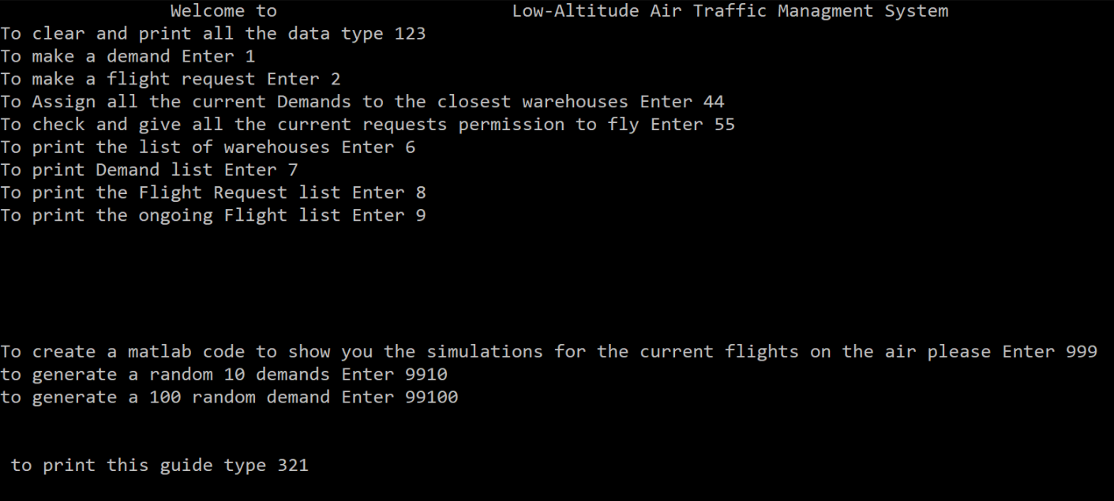

Slide 19
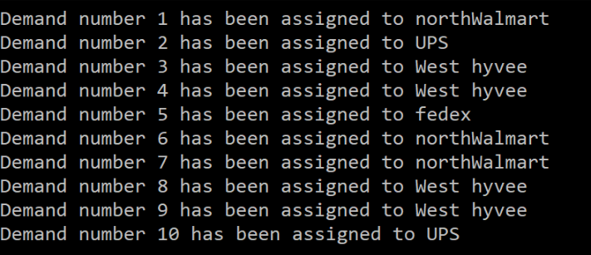

Slide 20
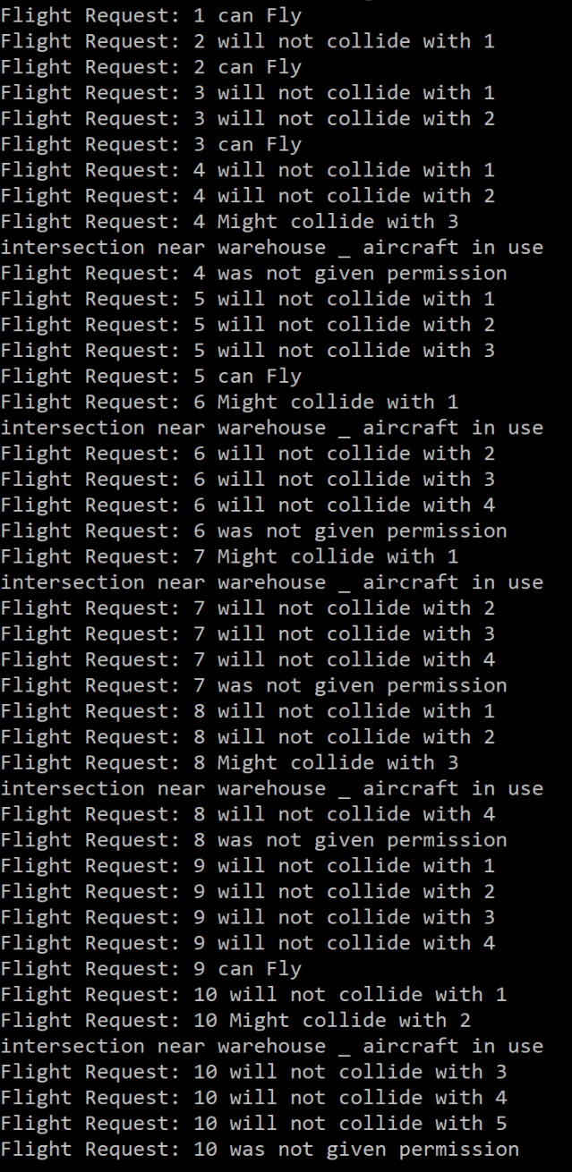

Slide 21
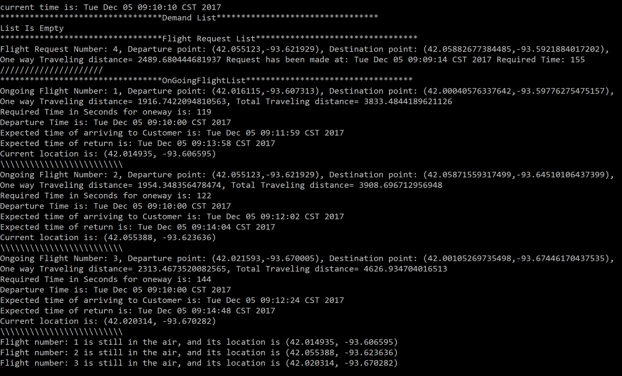

Slide 23
Thanks….
Questions?

